Slide 1
SECTOR Risk Profiles
Jack Stanton
Manager Intelligence Safety & Risk Analysis Unit

Slide 2
Sector risk profiles:
The CAA is going to conduct a Sector Risk Profile of the Agricultural Aviation Industry
What?
How ?
Who ?
Why ?

Slide 3
Policy Systems & interventions
DCA
Air Transport
General
Aviation
Infrastructure & Personnel
Policy & Systems Intervention
Flight OPs
Safety Investigation
Maintenance
Intelligence & Analysis
Strategy & Policy
Aircraft Certification
Regulatory Investigation
Safety Promotion

Slide 4

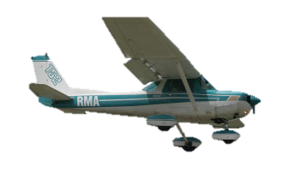
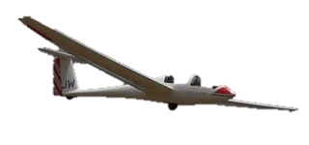
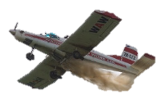
SECTOR definition
A collection of related aviation products, services, organisations or activities.
  Air Transport – Industry Sector
  Pilot Training – Operational Sector
  Gliding – Aircraft Sector
  Agricultural Aviation - Industry Sector

Slide 5
Sector Risk Profile
A list of safety risks faced by a sector.
  Identifies the risks
  Ranks the risks.
  Identifies mitigation measures.
  Allocates responsibility

Slide 6
What a risk profile looks like
Description of Risk | Impact | Risk Assessment |  |  | Treatment | Residual Risk
 |  | Consequence | Likelihood | Risk Level
Airframe Corrosion | Loss of structural integrity | Critical | Certain | Very High | Apply CPC Inspect at 6 month intervals | Low
Pilot fatigue | Pilots Slow reactions cause an accident | Critical | Likely | High | Provide a Relief Pilot | Medium

Slide 7
How is the risk profile done?
Essentially a comprehensive survey and opinion poll using a variety of methods.
  Interviews with industry participants
  Questionnaires
  Site visits

Slide 8

Who Does the RISK Profile?
Carried out by a third party with expertise in risk profiling.
  Survey Design
  Sample Sizes
  Stakeholder Identification
  Interviews
  Collect Results
CAA manages the scope, engagement of third party and oversight of the process.

Slide 9
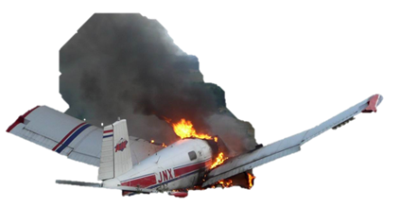
What’s in in a Sector Risk profile
What do consider your greatest risks?
What are the consequences?
How likely are they?
What can be done to avoid them?
  mitigation strategy
  responsibility

Slide 10
Risk MITIGATION
What can be done?
How well will it work?
A qualitative or ‘gut-feel’ analysis.
This mitigation will:
completely,
mostly,
or hardly
fix the problem.

Slide 11
Risk Profile Summary
Considering the mitigations, reassess the residual risk
Rank the safety risks from highest to lowest.
 | Description | Mitigation | Ranking
Risk 1 | Big problem | Fix 1
Risk 2 | Another Problem | Fix 2
Risk 3 | Not such a big problem | Fix 3

Slide 12
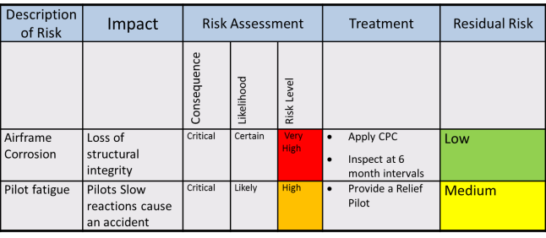

Sector Risk Profiles
What
How
Who

Slide 13
Sector RISk Profile
Why Agricultural Aviation?

Slide 14



Sector Risk Profiles

Slide 15
candidate Sectors for Risk Profiles
    Agricultural Aviation
    Pilot Training Industry
    Adventure Aviation

Slide 16
Application of Sector Risk profiles
Q: How do sector risk profiles fit into the CAA regulatory model?
A: Initial step in the regulatory process
  Identify problems
  Understand them
  Find ways to fix them

Slide 17
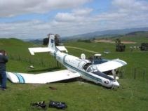
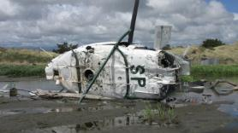
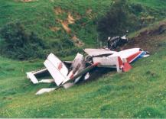
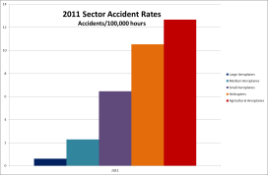




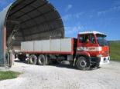
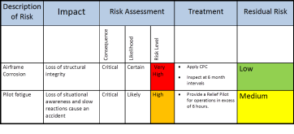

SECTOR RISK PROFILE
SHARED

Slide 18




Understand the issue
Identify regulatory tools
Select the best tool
e.g. Rule Project
e.g.
Audit Depth & Frequency
Other form of intervention
Part 137
AC-137

Slide 19



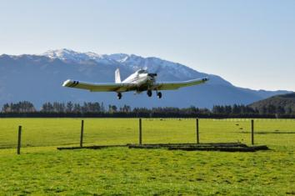
Notes:
Check Time, Continue If OK?

Slide 20
On mitigations….
Not all of the mitigations will be for CAA action
Some problems are best fixed by industry.
Some problems will require co-operation.
CAA
AAA
BOTH

Slide 21
Reporting Rates
Accident Rate = Accidents
Total Hours
Accidents are well reported to CAA

Slide 22
Reporting Rates cont..
Only 80% of Agricultural Operators provide quarterly statistics returns.
Notes:
Only 33% report by the due date of 4 weeks after the quarter --- Out of date stats
Lowest return rate amongst professional; operators

Slide 23
Reporting rates cont…
To compensate CAA ‘guesstimates’ total agricultural flying hours.
CAA may be underestimating total Ag hours.
Accident Rate = Accidents
Total Hours
Reporting hours may improve accident rate
(gives the true picture)

Slide 24

Final Slide
jack.stanton@caa.govt.nzz

